Slide 1

Lecture_3
Reading, Writing and Importing Data
Matthew Valentine
Office: Tech Room Lab K2
mvalentine@uwc.ac.za

Slide 2

Working with SAS Libraries and Permanent Data Sets
SAS Data sets are;
Are created by a data statement.
Are internal representation of the data created.
Contains more than just data values (Contains; variable names, labels, results, calculations and variable formats.
Are referred to by a name that indicates whether its permanent or temporary.
Difference between a temporary and permanent data set;
Temporary Data set – is named with a single level name. It is created in a DATA statement and is available for analysis only during the active session of SAS.
Permanent Data set – is a file saved on your hard-disk / Hard drive and is designed with a two-part name, such as REASRCH.SOMEDATA or MYSASLIB.MEASLES2009.

Slide 3
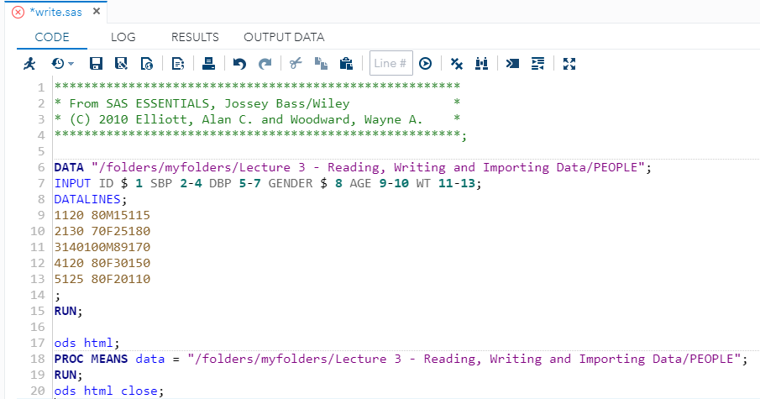
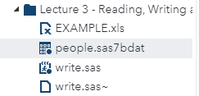
Reading and creating a permanent SAS data set
using windows file name technique
Instead of using a temporary SAS data set name such as “PEOPLE” in the SAS DATA statement, use a window file name for example, instead of using;
DATA PEOPLE;
/*use*/
DATA "C:\SASDATA\PEOPLE";
This creates a data set called “PEOPLE” on your hard drive in “C:\SASDATA\PEOPLE”.
The window file name of this permanent file would be PEOPLE.SAS7DBAT.
A windows file name can be used to read a permanent SAS Data set. To access the data in SAS, you could include the full Windows Path in a DATA = statement in any SAS PROC Statement.
Example: In the editor window, open the file WRITE.SAS

Slide 4
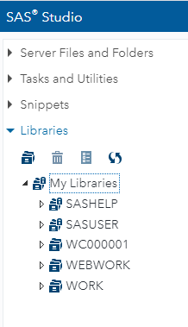
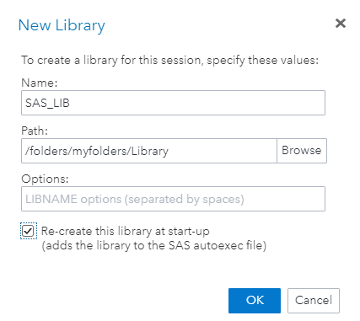
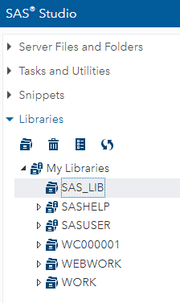
Creating a SAS library using the dialog box
In the explorer window click on the Drop Down “Library”, then click on the icon “New Library” .
Rename the Library to SAS_LIB, then click on Browse selected the folder that you have created called Library. This is where you will be placing all your datasets and SAS Programs and these will be automatically placed in your Library.

Slide 5
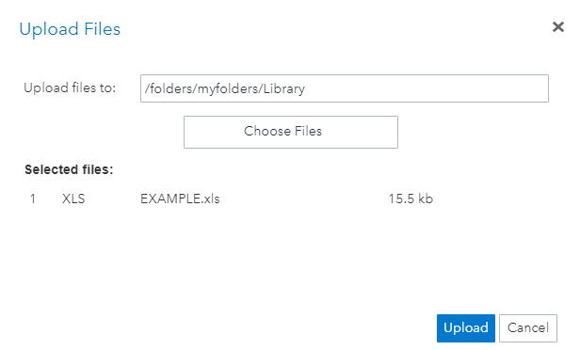
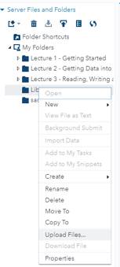
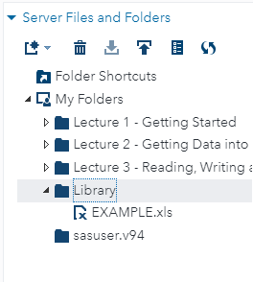
Uploading Data from another Program
SAS can also read in or import data from a variety of other formats. This can be done using a step-by-step Wizard.
Uploading Microsoft Excel Data (Criteria);
The first row should contain the names of the SAS variables and should adhere to SAS Naming conventions.
Each column in the spreadsheet should contain data corresponding to the variable name in row 1 and should be consistent with the desired variable type.
Blanks in the spreadsheet will be read as a missing value and replaced with a dot (.)
Uploading data using the Wizard;
Type of file to upload in this case is an excel workbook (XLS)

Slide 6
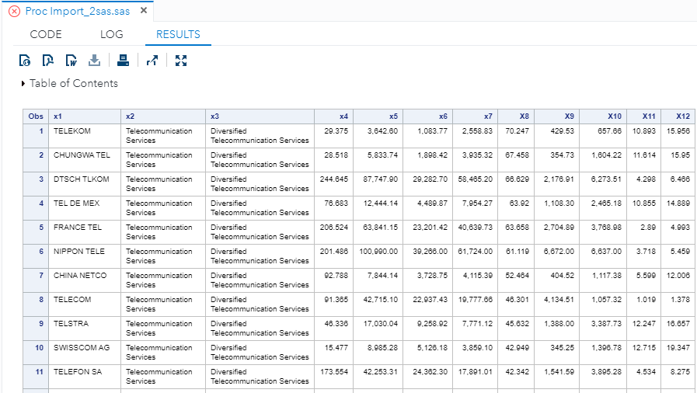
Viewing the data in your library (SASLIB)

Slide 7
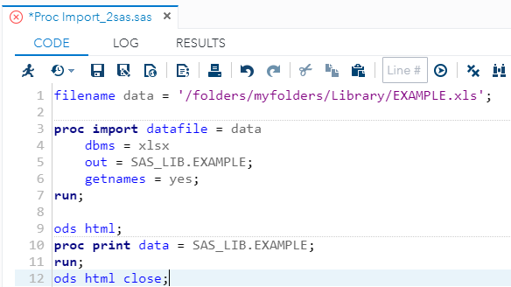
Importing Microsoft Excel Data Using SAS Code
Instead of using the import wizard to import Excel Data, you can use SAS Code.
The following program, “Proc Import_2”, imports a Excel spreadsheet EXAMPLE.XLS and creates a SAS Data set named SAS_LIB.EXAMPLE.
“out =“ – defines the output SAS data set
“datafile =“ – the input file (e.g. .xls)
“dbms =“ – indicates the type of file to be imported
“REPLACE” – overwrites previous files with the same name
“Sheet =“ – define which spreadsheet to use
“GetNames =“ – YES if the first row contains column names

Slide 8
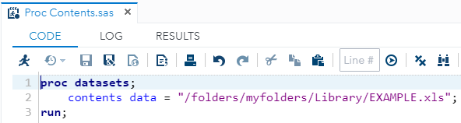
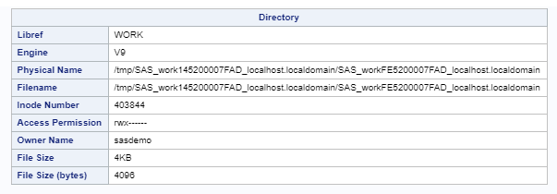
Checking the data set
Use this procedure to view information related to the data set ( e.g. variables names, variable widths etc.)

Slide 9
Study
Chapter 3
Matthew Valentine
Office: Tech Room Lab K2
Mvalentine@uwc.ac.za

